Slide 1
Test Levels SDLC v/s STLC
Lecture 4
Madiha Malik

Slide 2
Join Google Group for Course Material and Assignments.
https://groups.google.com/d/forum/software-testing-cs-497

Slide 3
Test Levels
A software system goes through four stages of testing before it is actually deployed.
Unit level testing
Integration level testing
System level testing
acceptance level testing.
The first three levels of testing are performed by a number of different stakeholders in the development organization
Acceptance testing is performed by the customers.

Slide 4
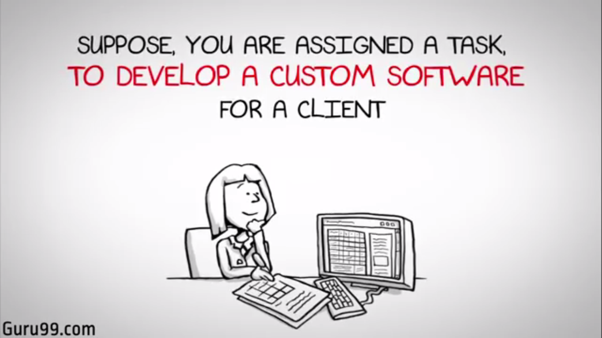
SDLC vs STLC
Suppose, you are assigned a task to develop a custom software for a client
There are certain steps required to develop a software

Slide 5
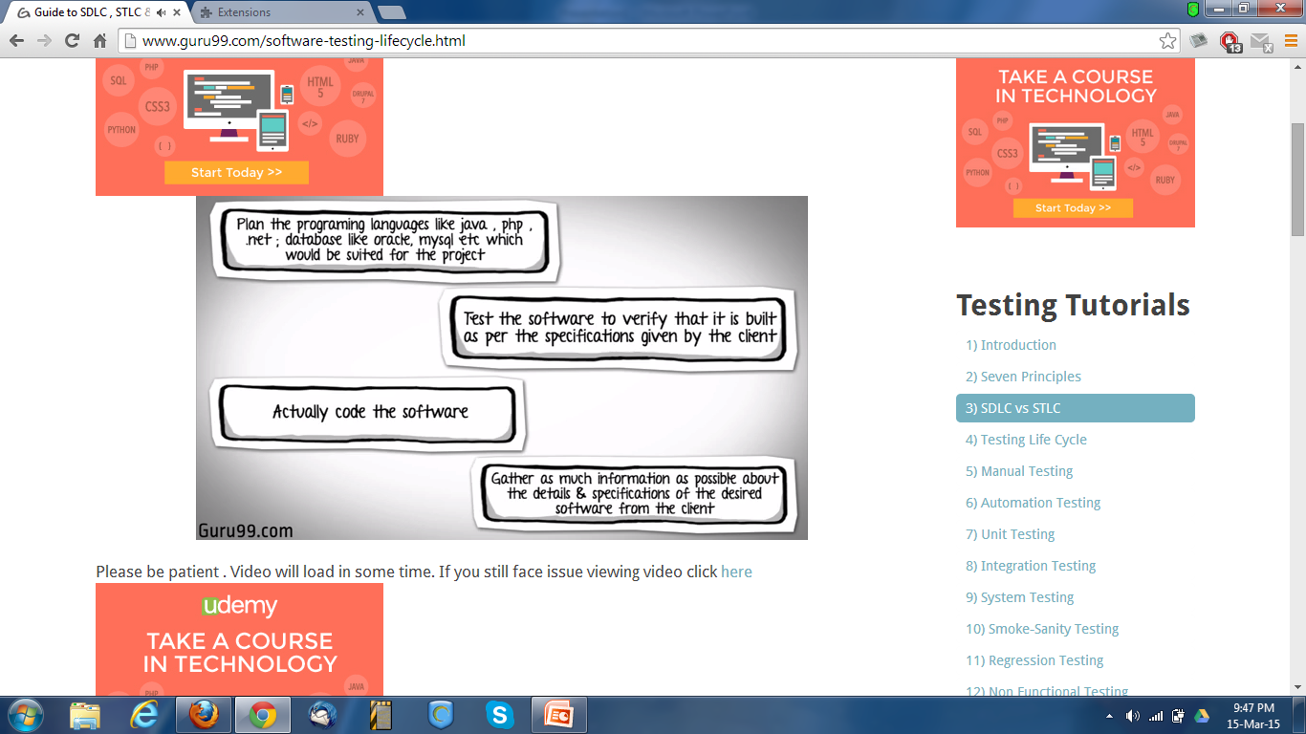
Notes:
Each block below represents a step required to develop the software.

Slide 6

Gather as much information as possible about the details & specifications of the desired software from the client.
Requirements
Plan the programming language like java, php, .net; database like oracle, mysql etc which would be suited for the project
Design
Actually code the software
Build
Test the software to verify that it is built as per the specifications given by the client
Test
Maintenance
Notes:
The correct sequence would be.
Gather as much information as possible about the details & specifications of the desired software from the client. This is nothing but the Requirements gathering stage.
Plan the programming language like java , php , .net ; database like oracle , mysql etc which would be suited for the project. also some high level functions & architecture. This is the Design Stage.
Actually code the software. This is the Built Stage.
Next you ,Test the software to verify that it is built as per the specifications given by the client. This is the TEST stage.
Once your software product is ready , you may to do some code changes to accommodate enhancements requested by the client. This would be Maintenance stage.

Slide 7

Requirements
Design
Software Development Life Cycle
SDLC
Waterfall Method
Build
Test
Maintenance
Notes:
All these levels constitute the waterfall method of software development lifecycle.As you may observe, that testing in the model starts only after implementation is done.

Slide 8
Waterfall Method
Requirements
Mistake in Requirements
Design
Design to meet Requirements
Build
Built to meet Design
Test
Wrong Product
Maintenance
You will have start afresh with project
Notes:
But if you are working in large project, where the systems are complex, its easy to miss out key details in the requirements phase itself. In such cases , an entirely wrong product will be delivered to the client. You will have to start a fresh with the project

Slide 9
Waterfall Method
Requirements
Requirements
Design
Design to meet Requirements
Build
Built to meet Design
Test
Wrong Product
Maintenance
Re-Design to correct Defects
Notes:
Or if you manage to note the requirements correctly but make serious mistakes in design and architecture of you software you will have to redesign the entire software to correct the error.

Slide 10
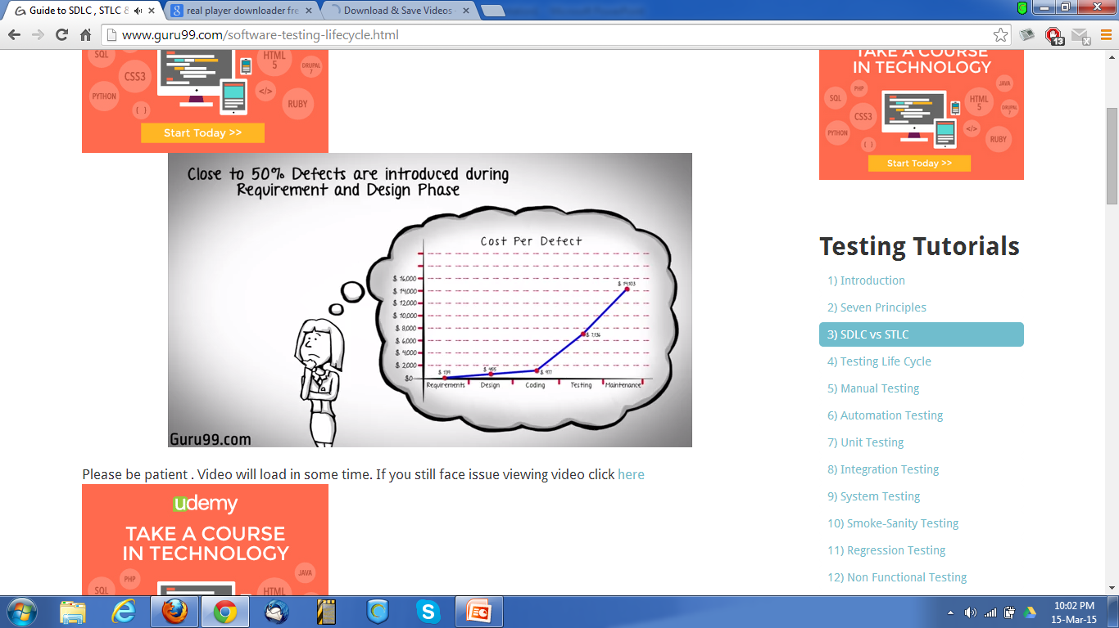
Close to 50% Defects are introduced during Requirement and Design phase
Assessment
Also, the costs of fixing a defect increases across the development life cycle
The earlier in life cycle a defect is detected, the cheaper it is to fix it.
Notes:
Assessments of thousands of projects have shown that defects introduced during requirements & design make up close to half of the total number of defects
Also, the costs of fixing a defect increases across the development life cycle. The earlier in life cycle a defect is detected, the cheaper it is to fix it. As the say, "A stitch in time saves a nine"

Slide 11
V-Model of Testing
SDLC
User Acceptance Test Plan
STLC
Requirement Analysis
User Acceptance Testing
System Test Plan
Functional Specification
System Testing
Integration Test Plan
High-Level Design
Integration Testing
Unit Test Plan
Detailed Design
Unit Testing
Code
Notes:
To address this concern , the V model of testing was developed where for every phase , in the Development life cycle there is a corresponding Testing phase
The left side of the model is Software Development Life Cycle - SDLC
The right side of the model is Software Test Life Cycle - STLC
The entire figure looks like a V , hence the name V - model
You a find a few stages different from the waterfall model.
These differences , along with the details of each testing phase will be discussed in later

Slide 12
Iterative Life Cycle
PHASE 1
PHASE 2
PHASE 3
So on
Requirements
Requirements
Requirements
Rapid Application Development
Agile Development
Design
Design
Design
Build
Build
Build
Test
Test
Test
Notes:
Apart from V model , there are iterative development models , where development is carried in phases , with each phase adding a functionality to the software.
Each phase comprises of, its own independent set of development and testing activities.
Good examples of Development lifecycles following iterative method are Rapid Application Development, Agile Development

Slide 13
Testing in a Life Cycle Model
There are numerous development life cycle models
Development model selected for a project, depends on the aims and goals of that project
Testing is not a stand-alone activity and it has to adopt with the development model chosen for the project.
In any model, testing should performed at all levels i.e. right from requirements until maintenance.
Notes:
Before we close this software testing training a few pointers -
You must note that, there are numerous development life cycle models.

Slide 14
Software Test Life Cycle
STLC

Slide 15
STLC
Contrary to popular belief, Software Testing is not a just a single activity.
It consists of series of activities carried out methodologically to help certify your software product.
These activities (stages) constitute the Software Testing Life Cycle (STLC).

Slide 16
The Different Stages in
Software Test Life Cycle

Slide 17
The Different Stages in STLC
There different stages in Software Test Life Cycle
Each of these stages have a definite Entry and Exit Criteria
Activities & Deliverables associated with it.
In an Ideal world you will not enter the next stage until the exit criteria for the previous stage is met.
But practically this is not always possible.

Slide 18
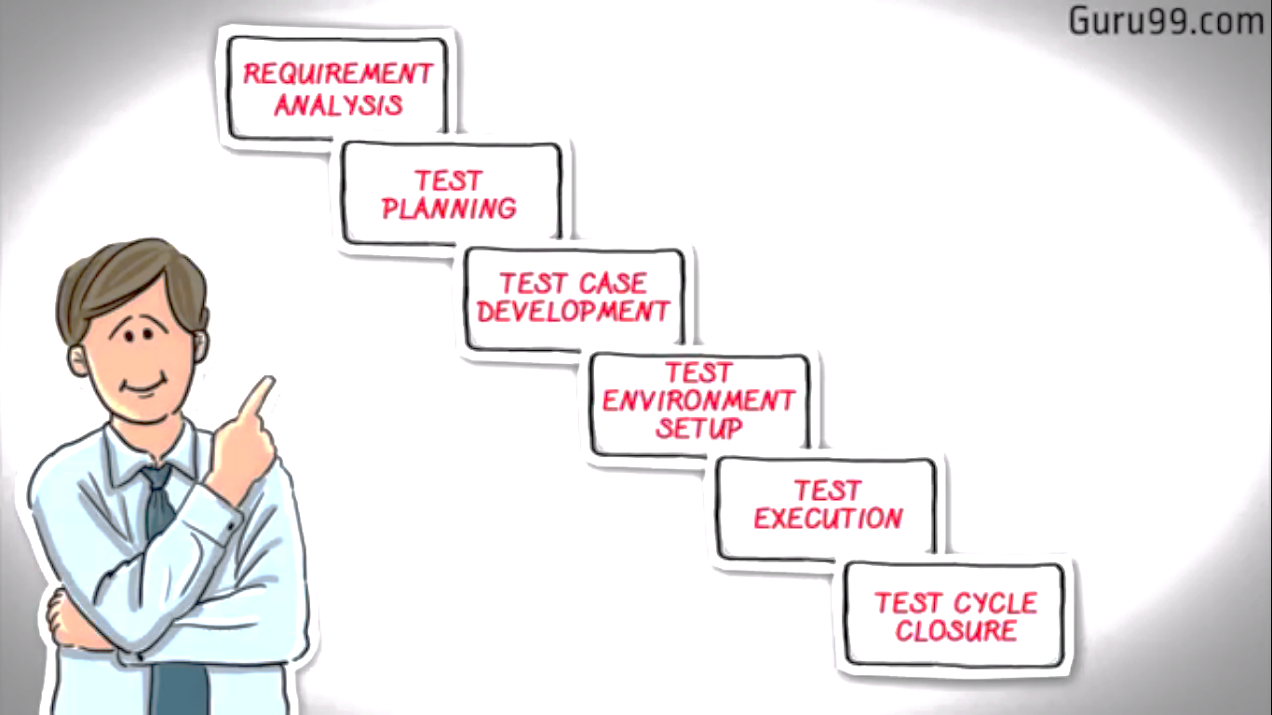
Stages of STLC

Slide 19
Requirement Analysis
During this phase, test team studies the requirements from a testing point of view
To identify the testable requirements.
The QA team may interact with various stakeholders to understand the requirements in detail.
Client, Business Analyst, Technical Leads, System Architects etc.
Requirements could be either
Functional (defining what the software must do) or
Non Functional (defining system performance /security availability)
Automation feasibility for the given testing project is also done in this stage.

Slide 20
Requirement Analysis (cont)
Activities:
Identify types of tests to be performed.
Gather details about testing priorities and focus.
Prepare Requirement Traceability Matrix (RTM).
Identify test environment details where testing is supposed to be carried out.
Automation feasibility analysis (if required).
Deliverables:
RTM
Automation Feasibility Report (if Applicable)

Slide 21
Test Planning
This phase is also called Test Strategy phase.
Typically , in this stage, a Senior QA manager will determine
Effort and cost estimates for the project
Prepare and finalize the Test Plan.

Slide 22
Test Planning (cont.)
Activities:
Preparation of test plan/strategy document for various types of testing
Test tool selection
Test effort estimation
Resource planning and determining roles and responsibilities.
Training requirement
Deliverables:
Test Plan /strategy document.
Effort Estimation document.

Slide 23
Test Case Development
This phase involves
creation, verification and rework of test cases & test scripts.
Test Data , is identified/created and is reviewed and then reworked as well.

Slide 24
Test Case Development(cont.)
Activities:
Create test cases, automation scripts (if applicable)
Review and baseline test cases and scripts
Create test data (If Test Environment is available)
Deliverables:
Test cases/scripts
Test data

Slide 25
Test Environment Setup
Test environment decides the software and hardware conditions under which a work product is tested.
Test environment set-up is one of the critical aspects of testing process and can be done in parallel with Test Case Development Stage.
Test team may not be involved in this activity if the customer/development team provides the test environment in which case the test team is required to do a readiness check (smoke testing) of the given environment.

Slide 26
Test Environment Setup(cont.)
Activities:
Understand the required architecture, environment set-up and prepare hardware and software requirement list for the Test Environment.
Setup test Environment and test data
Perform smoke test on the build
Deliverables:
Environment ready with test data set up
Smoke Test Results.

Slide 27
Test Execution
During this phase test team will carry out the testing based on
the test plans and the test cases prepared.
Bugs will be reported back to the development team for correction and retesting will be performed.

Slide 28
Test Execution(cont.)
Activities:
Execute tests as per plan
Document test results, and log defects for failed cases
Map defects to test cases in RTM
Retest the defect fixes
Track the defects to closure
Deliverables:
Completed RTM with execution status
Test cases updated with results
Defect reports

Slide 29
Test Cycle Closure
Testing team will meet , discuss and analyze testing artifacts
to identify strategies that have to be implemented in future,
taking lessons from the current test cycle.
The idea is to remove the process bottlenecks for future test cycles
and share best practices for any similar projects in future.

Slide 30
Test Cycle Closure(cont.)
Activities:
Evaluate cycle completion criteria based on Time, Test coverage, Cost, Software, Critical Business Objectives, Quality.
Prepare test metrics based on the above parameters.
Document the learning out of the project
Prepare Test closure report
Qualitative and quantitative reporting of quality of the work product to the customer.
Test result analysis to find out the defect distribution by type and severity.
Deliverables:
Test Closure report
Test metrics

